Slide 1
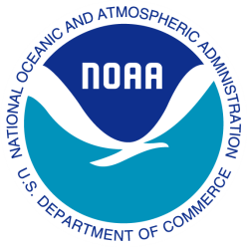
November 4, 2010
NOAA Technology Summit
Mary Glackin
Deputy Under Secretary for Operations National Oceanic and Atmospheric Administration | NOAA
1
Notes:
Mention that National Oceanographic Data Center is 50 years old as of November 1 2010.

Slide 2
Next Generation Strategic Plan
Notes:
Achievement of NOAA’s long-term goals “ will depend upon the continued strengthening and integration of NOAA’s enterprise-wide science and technology…”
The foundation of NOAA’s mission is built upon Earth observations – from satellites to DART buoys at the bottom of the ocean.
Integrated data management not just a NOAA priority, but a Federal government priority
Three elements of this science and technology enterprise goal
A holistic understanding of the Earth System through research
Accurate and reliable data from sustained and integrated Earth observing systems
An integrated environmental modeling system

Slide 3
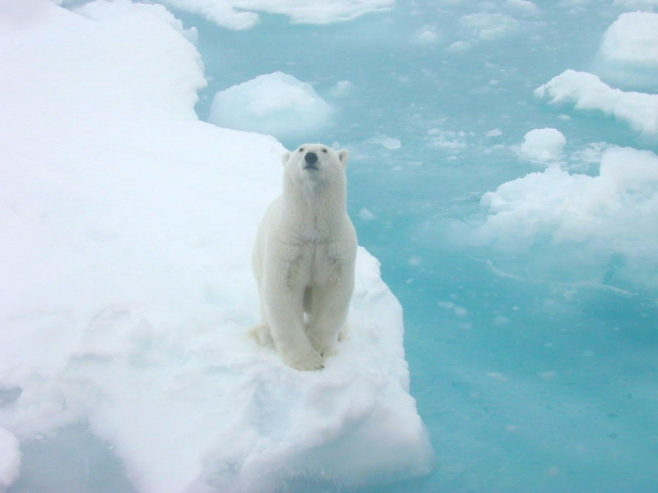
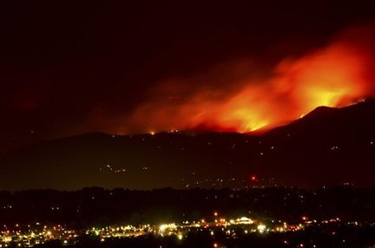
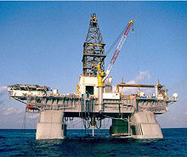
Rising Demands

Slide 4
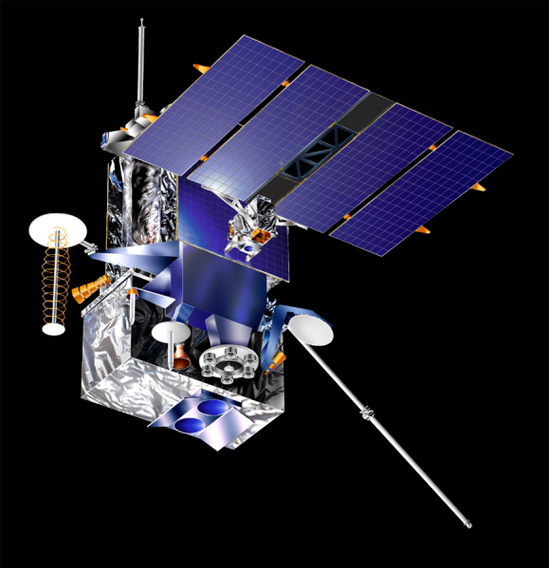
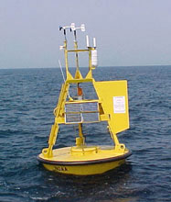
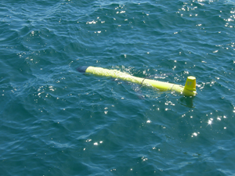
New Approaches –Observations
Notes:
To ensure the best use of the data collected by NOAA observing systems, now and into the future, the focus must be on making data accessible and transferable to others, emphasizing the need for NOAA collaboration
Through this objective, NOAA hopes to
Increase our ability to meet observation requirements
Harmonize data management standards to improve the usability and accessibility of data
Sustain, maintain, and where appropriate, expand our observation capabilities – including leveraging partnerships within and outside of NOAA

Slide 5
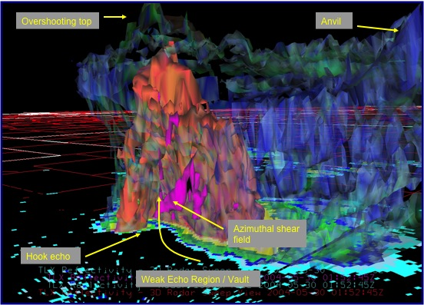
Modeling the Earth System
Notes:
This goal moves NOAA towards a comprehensive Earth system modeling capability, linking the full scope of models – from climatic to oceanic to ecologic
Through this objective, NOAA hopes to:
Improve the predictive accuracy of NOAA environmental models
Increase the use of models for ecological forecasting (i.e. Harmful Algal Blooms)
To achieve these objectives, NOAA must
Leverage partnerships with other Federal agencies
Expand the ability to integrate data from different observing systems to facilitate model validation

Slide 6
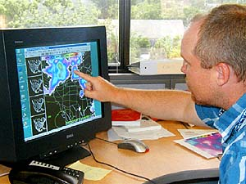
Right tool, Right time, Right place
Notes:
Need to build on that by integrating the observations of other parts of NOAA to create a holistic picture of the total Earth environment
NOAA is a consumer of it’s own products, therefore managing the data held across NOAA for better access by NOAA means integration and standardization of data formats and access channels
NOAA needs to move away from its current, fragmented approach to data collection/management and move towards an integrated, enterprise-wide model
New ways of presenting our data
What is NOAA’s “Geoplatform.gov?”
Can AWIPS II capabilities be extended to capture other data (ecological) and be useful to other users (Fishery Managers? Sanctuary managers?)
Stories of folks who could use a more NOAA-integrated tool like this
FEMA and other Federal, State, and local partners (key would be standardization of data formats!)
Note: A separate session focusing on geoplatform.gov is planned for after the lunch break.

Slide 7
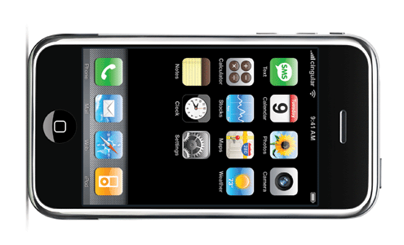
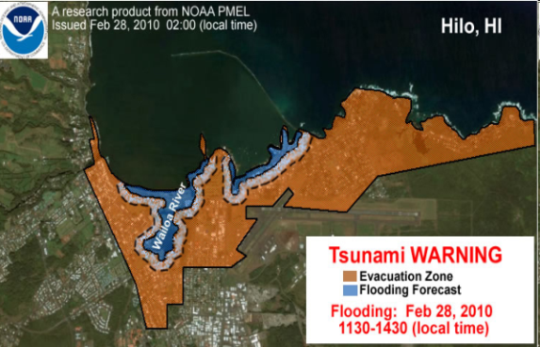
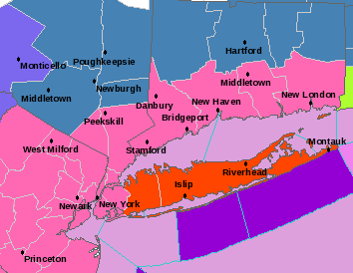
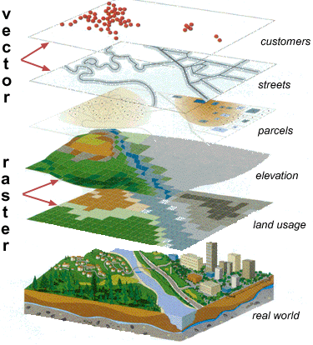
Delivering the Goods
During the Feb. 2010 snowstorms on the East Coast, Weather.gov had 2 billion hits.
Notes:
New ways of delivering our data and products
NWS website gets 63 millions hits per day;
But is also considered to be the second worst government website
Need to respond to the needs of the “e-Generation”
We are playing catch-up with the e-Generation
We need to find ways not only to integrate our data and observations, but deliver them in ways people demand today
We need to realize that in times of emergency (natural or manmade) alternative ways of delivering information might be necessary (not everyone is connected to the internet 24/7!)
Theme of the Summit “Technology supporting decision support”
Not only helping federal government manage resources, but helping the public make informed decisions that preserve resources, property, and life.
The best way for NOAA to meet the needs of its stakeholders is often simply to better deliver the data we already have. (theme of the NGSP S&T enterprise goal)

Slide 8
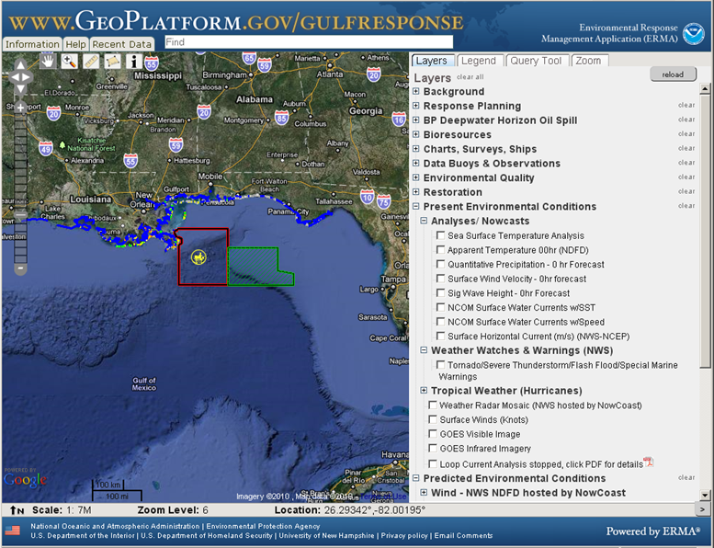
Working together effectively

Slide 9
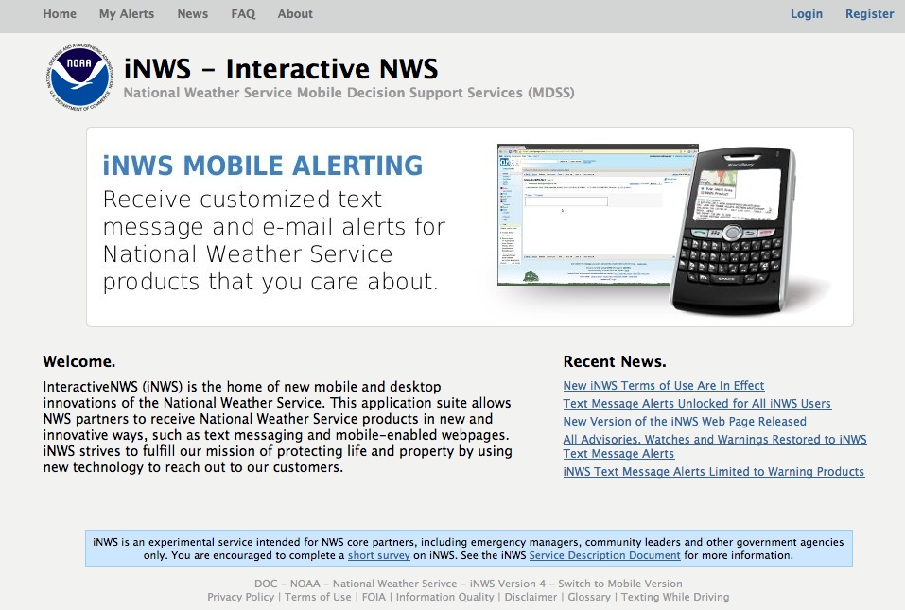
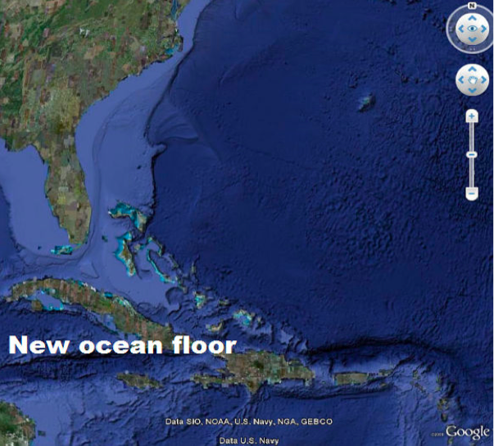
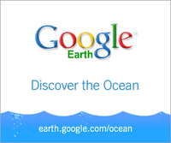
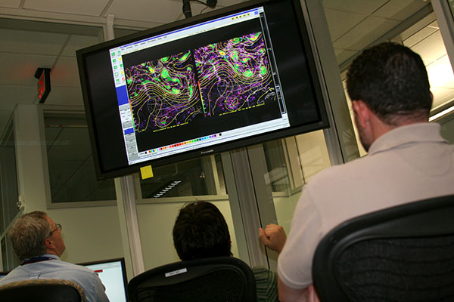
Building on success

Slide 10
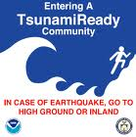
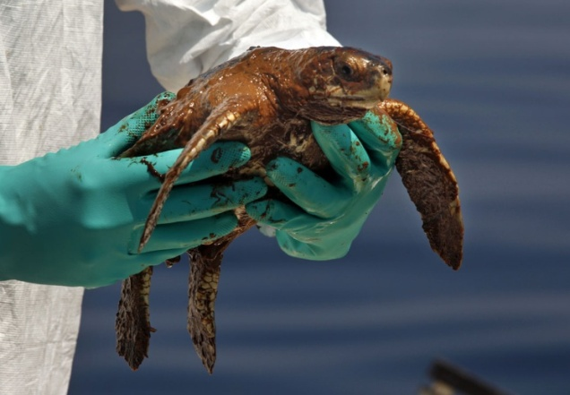
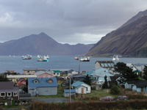
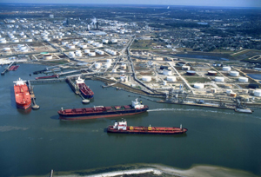
Resilient Ecosystems, Communities, Economies
Notes:
Through this objective NOAA seeks to:
Understand the interrelationships among climate, weather, oceans, ecosystems, and human activities
Incorporate social, behavioral, and economic research into delivery of NOAA climate, weather, ocean and coastal services
Support work in renewable energy with meteorological, climatic, and oceanic research
Improve understanding of Earth systems and ecosystems, including unexplored and ecologically, economically, and culturally important regions
To achieve this objective, NOAA needs:
An innovative, advanced research capability to push forward our understanding of the Earths systems
An accessible suite of a wide range of data, from climate and weather obs to ecosystem and living marine resources
Tools and technologies to observe, model, and communicate our knowledge

Slide 11
Questions/Comments

